Slide 2
Objectives
To gain a basic understanding of the Accounting Pathway.
To discover career options available within the Accounting Pathway.
To explore the working environment, educational requirements, skills needed and salary of careers available within the Accounting Pathway.

Slide 3
Pathway Overview
Careers focus on the development and utilization of accounting software and practices to help businesses make informed decisions regarding financial matters

Slide 4
Accounting Clerk
Career description:
manage numerical data to keep financial records complete
verify accuracy of figures, calculations and postings regarding business transactions
use accounting software to record, store and analyze information

Slide 5
Accounting Clerk
Career description:
calculate, prepare and issue financial statements
compile statistical, financial, accounting or auditing statistics for reports

Slide 6
Accounting Clerk
Education/training:
high school diploma or equivalent
associate’s degree in business or accounting may be required
Median salary:
$34,740

Slide 7
Bookkeeper
Career description:
handle all financial transactions and record keeping
record transactions
prepare financial statements
create reports and summaries for managers

Slide 8
Bookkeeper
Education/training:
high school diploma is minimum requirement
associate’s degree in business or accounting may be required
certification important for advancement
Median salary:
$34,740

Slide 9
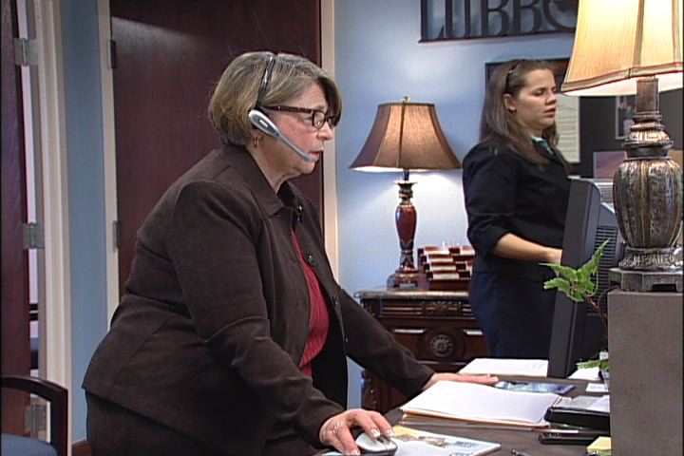
Billing Clerk
Career description:
collect data, determine fees and charges and prepare invoices for billing customers
calculate costs and rates for goods, services and shipment

Slide 10
Billing Clerk
Career description:
contact customers to obtain or deliver account information
use computer or typewriter, calculator and bookkeeping machines

Slide 11
Billing Clerk
Education/training:
high school diploma required
college coursework or degree is preferred
Median salary:
$32,880

Slide 12
Accountant
Career description:
examine financial information and prepare financial reports
calculate taxes owed and prepare tax returns
analyze all aspects of business operations to determine future revenues and expenses
report findings on the finances of an establishment

Slide 13
Accountant
Education/training:
bachelor’s degree in accounting or a related field
certification or licensure gives advantage in job market
Median salary:
$62,850

Slide 14
Auditor
Career description:
collect and analyze financial data to look for fraud, regulation violations and more
determine financial status of establishment and arrange financial reports
inform management of asset organization and audit results

Slide 15
Auditor
Career description:
suggest changes in operations and financial activities
prepare in-depth reports on audit findings

Slide 16
Auditor
Education/training:
bachelor’s degree in accounting or a related field
master’s degree in accounting or business administration may be necessary
Median salary:
$62,850

Slide 17
Adjuster
Career description:
plan and schedule claim processing for damage to property
investigate claims by interviewing clients and witnesses
talk with professionals such as lawyers and physicians to gather expert opinions

Slide 18
Adjuster
Career description:
gather information such as photos to put into reports
negotiate with claimant to settle claims

Slide 19
Adjuster
Education/training:
college degree in a related field such as business administration preferred
Median salary:
$59,320

Slide 20
Chief Financial Officer/Treasurer
Career description:
direct an organization’s financial goals and budgets
manage investments of funds and risks

Slide 21
Chief Financial Officer/Treasurer
Career description:
oversee cash management activities
perform capital raising strategies
handle mergers and acquisitions

Slide 22
Chief Financial Officer/Treasurer
Education/training:
bachelor’s degree or higher in business administration or a related field
Median salary:
varies widely

Slide 23
Billing Supervisor
Career description:
coordinate and manage all billing activities and personnel
handle customer complaints and questions regarding policies and procedures
help employees handle difficult or complex problems and complaints

Slide 24
Billing Supervisor
Career description:
train or arrange for training of employees
recruit, interview and hire employees

Slide 25
Billing Supervisor
Education/training:
college training or vocational experience preferred
Median salary:
$48,810

Slide 26
Discussion Questions
Describe the Accounting Pathway and the careers available within the pathway.
What education and training requirements are needed for most careers in this pathway?
What are the working conditions for most careers in this pathway?

Slide 27
Discussion Questions
Describe the average earnings of some careers in this pathway and why they differ from other careers.
List three character traits you possess which would make you successful in a career in this pathway.

Slide 28
Resources
U.S. Department of Labor. Occupational Outlook Handbook.
Washington, D.C.: Jist Works, 2013.
http://online.onetcenter.org/

Slide 29
Acknowledgements
Production Coordinators
Holly Mannan
John Carroll
Graphics Designer
John Carroll
Technical Writer
Jessica Odom
Vice President of
Brand Management
Clayton Franklin
Executive Producer
Gordon Davis, Ph.D.
©MMXIII
CEV Multimedia. Ltd.

