Slide 2
Objectives
To gain a basic understanding of the Construction Pathway.
To discover career options available within the Construction Pathway.
To explore the working environment, educational requirements, skills needed and salary of careers available within the Construction Pathway.

Slide 3
Pathway Overview
Careers focus on the building and inspecting of various structures including:
homes
apartment complexes
office buildings
highways

Slide 4
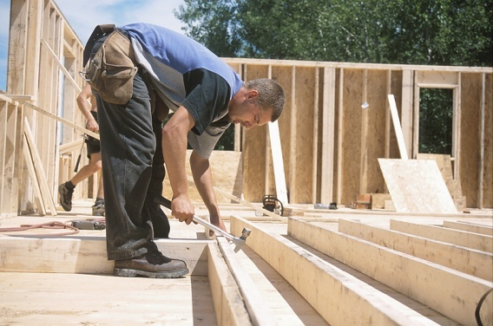
Carpenter
Career description:
construct and repair structures and fixtures of various woods
prepare cutting lines on materials with a ruler, pencil, chalk and marking gauge
practice and follow safety regulations

Slide 5
Carpenter
Career description:
confirm trueness and steadiness of structure
shape and cut materials to specific measurements

Slide 6
Carpenter
Education/training:
vocational schools and community colleges offer programs
takes three to four years of classroom and on-the-job training
Median salary:
$39,530

Slide 7
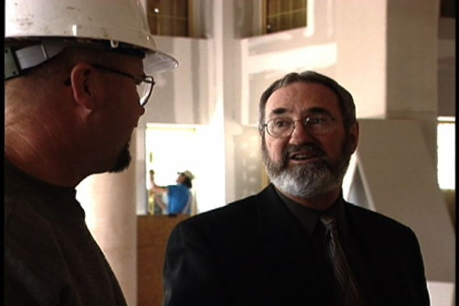
Construction & Building Inspector
Career description:
inspect buildings for structural soundness and compliance to building codes and other regulations
inspections may be general or limited to a specific area such as electrical or plumbing
use various instruments, metering devices, tape measures and test equipment

Slide 8
Construction & Building Inspector
Career description:
inspect various structures, systems and foundations before and after construction
keep daily logs and inspection records

Slide 9
Construction & Building Inspector
Education/training:
associate’s degree in engineering or architecture
Median salary:
$52,360

Slide 10
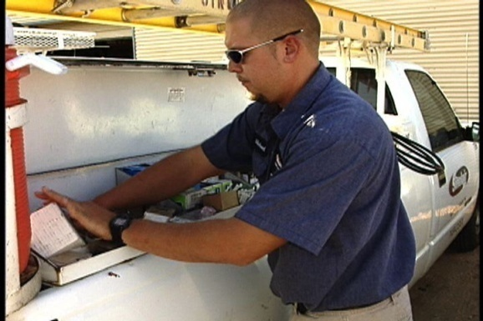
Construction Manager
Career description:
plan, organize and budget construction of buildings
assist with development of a construction project
monitor organization, scheduling and completion of project

Slide 11
Construction Manager
Career description:
work with supervisors, owners, contractors and design professionals
schedule steps of a project and budget time to meet deadlines

Slide 12
Construction Manager
Education/training:
bachelor’s degree in construction science, construction management or civil engineering
Median salary:
$83,860

Slide 13
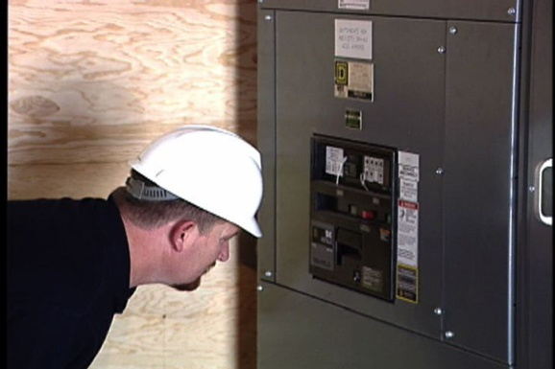
Electrician
Career description:
install, maintain and fix electrical wiring, equipment and fixtures
ensure work follows relevant codes
install or repair street lights, intercom systems or electrical control systems

Slide 14
Electrician
Career description:
solve causes of malfunctioning systems using test equipment and hand tools
attach wires to circuit breakers, transformers and other components

Slide 15
Electrician
Education/training:
high school diploma and four year apprenticeship programs
Median salary:
$48,250

Slide 16
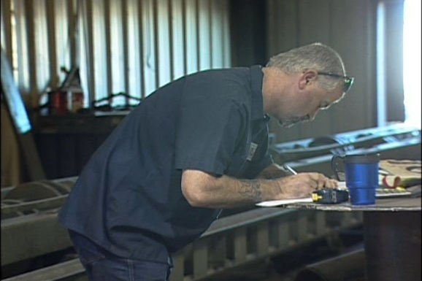
Iron/Metal Worker
Career description:
form completed structures or structural frameworks with iron or steel structures
build metal storage tanks and assemble prefabricated metal buildings
use specifications and blueprints to set location, quantity and size of materials needed

Slide 17
Iron/Metal Worker
Career description:
using blueprints and instructions, join columns, beams and girders with bolts
operate machines to manipulate metal

Slide 18
Iron/Metal Worker
Education/training:
high school diploma and completion of a three to four year apprenticeship program
Median salary:
$44,540

Slide 19
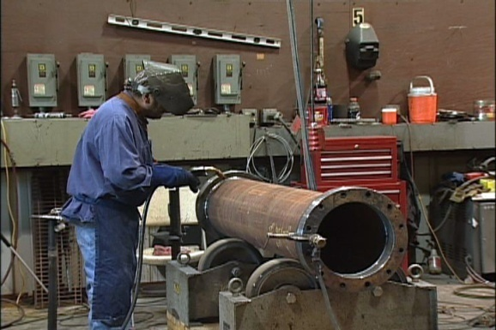
Pipe Fitter
Career description:
install and repair pipe systems and pipe supports
install and repair related hydraulic and pneumatic equipment
manipulate pipe to specifications, using saws, cutting torches, pipe threaders and benders

Slide 20
Pipe Fitter
Career description:
weld, braze, cement, solder and thread pipe joints
connect pipes to walls, structures and fixtures with brackets, clamps, tools or welds

Slide 21
Pipe Fitter
Education/training:
high school diploma
four to five year formal apprenticeship programs usually required
Median salary:
$46,660

Slide 22
Plumber
Career description:
construct, install and repair bathtubs, sinks, showers, toilets and appliances
install and repair water, waste disposal drainage and gas systems in buildings
fill pipes with air or water and watch pressure gauges to detect and locate leaks

Slide 23
Plumber
Career description:
examine blueprints, building codes and specifications to establish work details and procedures
make cost estimates and negotiate contracts

Slide 24
Plumber
Education/training:
career and technical schools and community colleges offer certification
apprenticeship and on-the-job training necessary
Median salary:
$46,650

Slide 25
Discussion Questions
Describe the Construction Pathway and the careers available within the pathway.
What education and training requirements are needed for most careers in this pathway?
What are the working conditions for most careers in this pathway?

Slide 26
Discussion Questions
Describe the average earnings of some careers in this pathway and why they differ from other careers.
List three character traits you possess which would make you successful in a career in this pathway.

Slide 27
Resources
U.S. Department of Labor. Occupational Outlook Handbook.
Washington, D.C.: Jist Works, 2013.
http://online.onetcenter.org/

Slide 28
Acknowledgements
Production Coordinator
Holly Mannan
John Carroll
Graphics Designer
John Carroll
Technical Writer
Jessica Odom
Vice President of
Brand Management
Clayton Franklin
Executive Producer
Gordon Davis, Ph.D.
CEV Multimedia. Ltd.
©MMXIII

