Slide 2
Objectives
To gain a basic understanding of the Engineering and Technology Pathway.
To discover career options available within the Engineering and Technology Pathway.
To explore the working environment, educational requirements, skills needed and salary of careers available within the Engineering and Technology Pathway.

Slide 3
Pathway Overview
Careers focus on the development of new technologies aimed at creating solutions for today’s problems
Can work in a wide variety of areas, including:
architecture
biotechnology
mechanics
construction

Slide 4
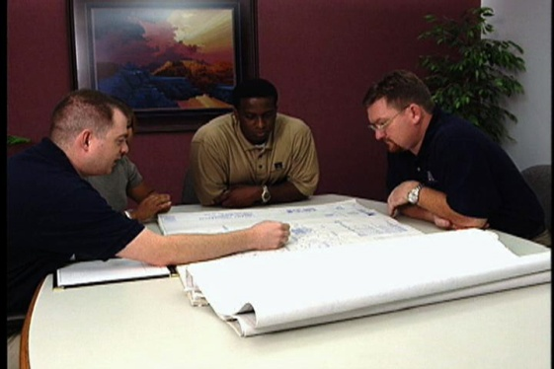
Aeronautical Engineer
Career description:
design, construct and test aircrafts, missiles and spacecraft
suggest improvements in testing equipment and techniques
develop design of aeronautical or aerospace products or systems

Slide 5
Aeronautical Engineer
Career description:
guide and organize activities of engineering or technical personnel
create and design criteria for testing methods, production costs, quality standards and completion dates
evaluate uses of materials and equipment

Slide 6
Aeronautical Engineer
Education/training:
bachelor’s degree or higher in engineering usually the minimum requirement
master’s or doctoral degree required for placement within many companies
Median salary:
$102,420

Slide 7
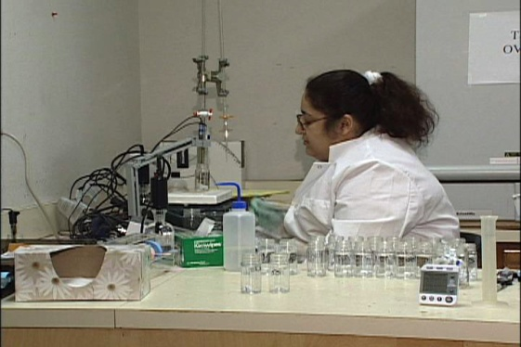
Chemical Engineer
Career description:
create chemical plant equipment and develop ways to manufacture chemicals and products
develop safety procedures for employees working with equipment and chemical reactions

Slide 8
Chemical Engineer
Career description:
establish best arrangement of operations such as mixing, crushing, heat transfer, distillation and drying
establish degree of control over production variables such as temperature and pressure

Slide 9
Chemical Engineer
Education/training:
bachelor’s degree or higher in chemistry usually the minimum requirement
master’s or doctoral degree required for placement within many companies
Median salary:
$92,930

Slide 10
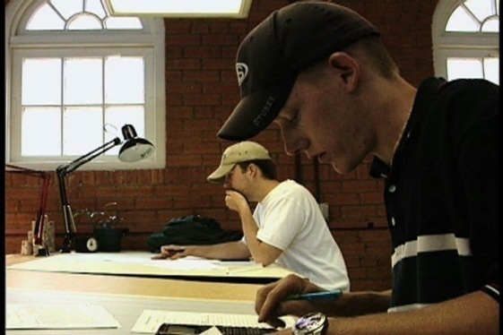
Civil Engineer
Career description:
plan, design and manage construction and maintenance of buildings and other facilities
examine topographical or geological data to plan projects

Slide 11
Civil Engineer
Career description:
plan and create transportation or hydraulic systems and structures
calculate load and grade requirements, water flow rates and material stress factors

Slide 12
Civil Engineer
Education/training:
bachelor’s degree or higher in civil engineering usually the minimum requirement
master’s or doctoral degree required for placement within many companies
Median salary:
$77,990

Slide 13
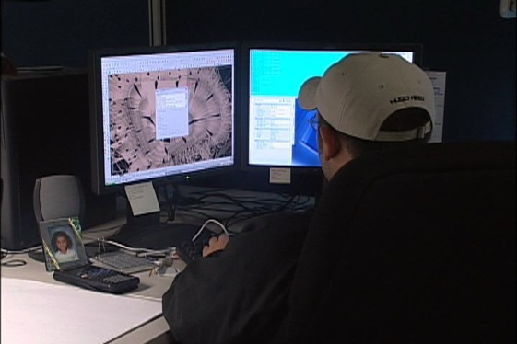
Industrial Engineer
Career description:
create, test and evaluate integrated systems for managing industrial production processes
examine statistical data and specifications to determine standards of finished product

Slide 14
Industrial Engineer
Career description:
suggest ways to improve productivity through management of personnel, materials and utilities
establish manufacturing methods, labor utilization standards and cost analysis systems

Slide 15
Industrial Engineer
Education/training:
bachelor’s degree or higher in engineering is usually the minimum requirement
master’s or doctoral degree required for placement within many companies
Median salary:
$77,240

Slide 16
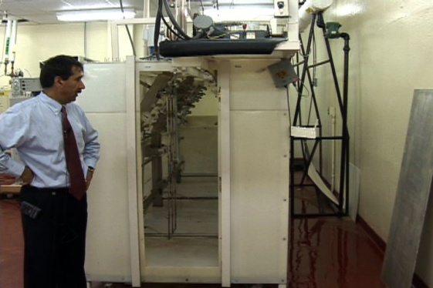
Mechanical Engineer
Career description:
research and design tools, engines, machines and other mechanical equipment
manage installation, operation, maintenance and repair of various mechanical systems
utilize blueprints, technical drawings, schematics and computer-generated reports

Slide 17
Mechanical Engineer
Career description:
work with others to apply operating procedures, handle malfunctions and offer technical information

Slide 18
Mechanical Engineer
Education/training:
bachelor’s degree or higher in mechanical engineering usually the minimum requirement
Median salary:
$79,230

Slide 19
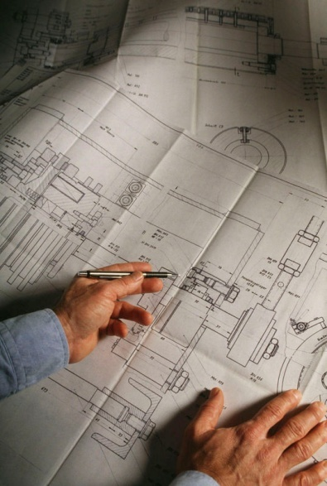
Drafter
Career description:
prepare technical drawings and plans for production and construction workers
create drawings which provide visual guidelines for products and structures

Slide 20
Drafter
Career description:
provide technical details using information from engineers, surveyors, architects and scientists

Slide 21
Drafter
Education/training:
postsecondary training in drafting usually necessary
Median salary:
ranges vary, depending on specialty from $47,250 to $54,470

Slide 22
Technical Writer
Career description:
write technical materials such as equipment manuals or operating/maintenance instructions
review and edit materials written by others
work with others to determine technical specifications and material for publication

Slide 23
Technical Writer
Education/training:
bachelor’s degree or higher in journalism, communications or English preferred
Median salary:
$64,610

Slide 24
Discussion Questions
Describe the Engineering and Technology Pathway and the careers available within the pathway.
What education and training requirements are needed for most careers in this pathway?
What are the working conditions for most careers in this pathway?

Slide 25
Discussion Questions
Describe the average earnings of some careers in this pathway and why they differ from other careers.
List three character traits you possess which would make you successful in a career in this pathway.

Slide 26
Resources
U.S. Department of Labor. Occupational Outlook Handbook.
Washington, D.C.: Jist Works, 2013.
http://online.onetcenter.org/

Slide 27
Acknowledgements
Production Coordinators
Holly Mannan
John Carroll
Graphics Designer
John Carroll
Technical Writer
Jessica Odom
Vice President of
Brand Management
Clayton Franklin
Executive Producers
Gordon Davis, Ph.D.
CEV Multimedia. Ltd.
©MMXIII

