Slide 2
Objectives
To gain a basic understanding of the Law Enforcement Services Pathway.
To discover career options available within the Law Enforcement Services Pathway.
To explore the working environment, educational requirements, skills needed and salary of careers available within the Law Enforcement Services Pathway.

Slide 3
Pathway Overview
Careers focus on the protection of the public, maintaining order and enforcing laws and regulations
Duties include:
investigating criminal activity
studying evidence
keeping order in court rooms
working with the public

Slide 4
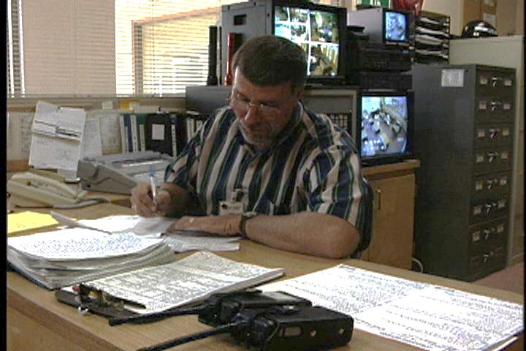
Criminal Investigator/ Special Agent
Career description:
investigate suspected criminal violations of federal, state or local laws
gather and confirm evidence by interviewing and watching suspects and witnesses and reading reports

Slide 5
Criminal Investigator/ Special Agent
Career description:
use cameras and photocopies to keep record of evidence and documents
analyze records to find links in chains of evidence or information
establish if evidence is adequate for recommending prosecution

Slide 6
Criminal Investigator/ Special Agent
Education/training:
bachelor’s degree or higher in a related field such as criminal justice is typically required
must be U.S. citizen, 20 years old, pass physical and personal qualifications

Slide 7
Criminal Investigator/ Special Agent
Education/training:
federal positions require minimum of 21 years old, no older than 37 at time of appointment
Median salary:
$71,770

Slide 8
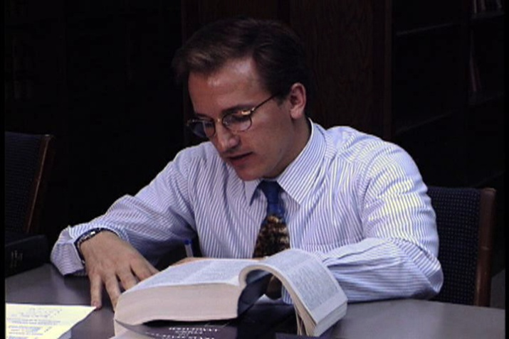
Immigration & Customs Inspector
Career description:
examine persons, common carriers, goods and merchandise arriving or departing from the United States or between states
inspect immigration applications, visas, passports and perform interviews

Slide 9
Immigration & Customs Inspector
Career description:
hold people who are in violation of customs or immigration laws and arrange legal action
find and confiscate contraband, undeclared merchandise, vehicles, aircrafts or boats containing such merchandise

Slide 10
Immigration & Customs Inspector
Education/training:
bachelor’s degree usually required
younger than 37 at time of appointment
have a valid driver licenses and pass an exam
Median salary:
$71,770

Slide 11
Police Officer
Career description:
enforce laws and ordinances, monitor traffic, control crowds, prevent crime and make arrests
keep order, respond to emergencies, protect people/property and enforce laws

Slide 12
Police Officer
Career description:
encourage positive community relations
record happenings to prepare reports documenting incidents and activities

Slide 13
Police Officer
Education/training:
college is generally required
training in police academy for 12 to 14 weeks
training covers law, civil rights, state laws, accident investigation, use of firearms, self defense and more

Slide 14
Police Officer
Education/training:
may hire high school graduates as cadets or trainees until the minimum age of 20 or 21 is met
Median salary:
$54,230

Slide 15
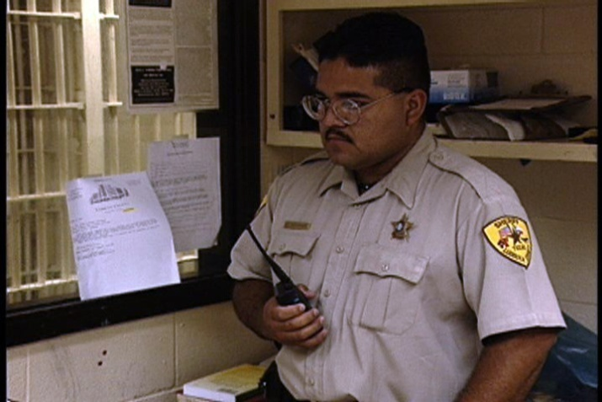
Sheriff & Deputy Sheriff
Career description:
keep law and order in rural areas and serve legal processes of courts
monitor courthouse, guard court or grand jury and usher defendants
monitor specific areas to find law violators, give citations and make arrests

Slide 16
Sheriff & Deputy Sheriff
Career description:
investigate illegal or suspicious activities
confirm proper legal charges were made against law offenders
carry out arrest warrants
find and take persons into custody

Slide 17
Sheriff & Deputy Sheriff
Education/training:
college in a related field such as criminal justice usually preferred
Median salary:
$54,230

Slide 18
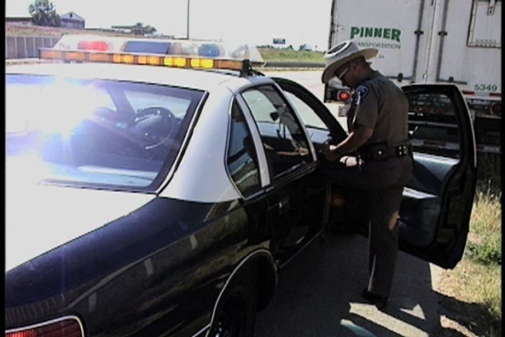
Police Detective
Career description:
perform investigations to solve criminal cases or prevent crimes
inspect crime scenes to gather clues and evidence, such as loose hairs, clothing or weapons

Slide 19
Police Detective
Career description:
gather evidence from suspects
give testimony as a witness in court
protect deceased bodies for medical examiner's inspection

Slide 20
Police Detective
Education/training:
bachelor’s degree or higher in a related field such as criminal justice preferred
must be U.S. citizen, 20 years old, pass physical and personal qualifications

Slide 21
Police Detective
Education/training:
federal positions require minimum of 21 years old, no older than 37 at time of appointment
Median salary:
$71,770

Slide 22
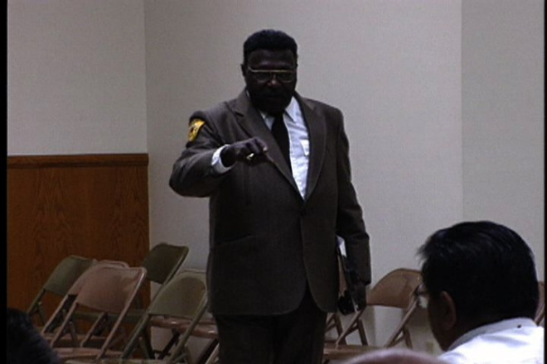
Bailiff
Career description:
keep order in courts of law
gather and keep unauthorized firearms from entering courtroom
protect jury from outside contact
guard housing of jury

Slide 23
Bailiff
Education/training:
college is generally preferred
Median salary:
$38,950

Slide 24
Evidence Technician
Career description:
gather and review physical evidence related to criminal investigations
determine significance of weapons and substances to investigation
act as an expert witness on evidence or crime laboratory techniques

Slide 25
Evidence Technician
Career description:
may specialize in areas, such as ballistics, fingerprinting, handwriting or biochemistry
report on the detailing findings, methods and laboratory techniques

Slide 26
Evidence Technician
Career description:
use and maintain laboratory equipment
recognize and classify substances, materials and other evidence found at crime scenes

Slide 27
Evidence Technician
Education/training:
bachelor’s degree or higher in a related field generally preferred
Median salary:
$52,180

Slide 28
Animal Control Officer
Career description:
collect abandoned, dangerous or unattended animals
investigate reports of animal attacks or animal cruelty, interview witnesses, collect evidence and write reports

Slide 29
Animal Control Officer
Career description:
collect and remove uncontrolled or abused animals from harsh conditions
inspect animals for injuries or malnutrition and organize necessary medical treatment

Slide 30
Animal Control Officer
Education/training:
college in a related field generally preferred
Median salary:
$32,460

Slide 31
Discussion Questions
Describe the Law Enforcement Services Pathway and the careers available within the pathway.
What education and training requirements are needed for most careers in this pathway?
What are the working conditions for most careers in this pathway?

Slide 32
Discussion Questions
Describe the average earnings of some careers in this pathway and why they differ from other careers.
List three character traits you possess which would make you successful in a career in this pathway.

Slide 33
Resources
U.S. Department of Labor. Occupational Outlook Handbook.
Washington, D.C.: Jist Works, 2013.
http://online.onetcenter.org/

Slide 34
Acknowledgements
Production Coordinators
Holly Mannan
John Carroll
Graphics Designer
John Carroll
Technical Writer
Jessica Odom
Vice President of
Brand Management
Clayton Franklin
Executive Producers
Gordon Davis, Ph.D.
CEV Multimedia. Ltd.
©MMXIII

