Slide 2
Objectives
To gain a basic understanding of the Marketing Communications Pathway.
To discover career options available within the Marketing Communications Pathway.
To explore the working environment, educational requirements, skills needed and salary of careers available within the Marketing Communications Pathway.

Slide 3
Pathway Overview
Careers are responsible for the development and implementation of advertising and public relations campaigns
Duties include:
working with the media
communicating with the public
overseeing advertising campaigns

Slide 4
Media Specialist
Career description:
support or develop positive advertising for individuals, groups or organizations
write or choose constructive publicity material
make and arrange displays and give speeches

Slide 5
Media Specialist
Career description:
develop positive relationships with community, consumer, employee and public interest groups
answer requests for information from the media

Slide 6
Media Specialist
Education/training:
college degree in related field such as public relations generally the minimum requirement
Median salary:
$53,190

Slide 7
Public Relations Specialist
Career description:
organize and direct public relations programs to maintain a positive public image
plan fundraising activities for special projects and nonprofit organizations

Slide 8
Public Relations Specialist
Career description:
locate client groups and audiences determining the best methods of communicating publicity
write effective press releases

Slide 9
Public Relations Specialist
Career description:
create and maintain company's corporate image and identity
prepare information for media kits and manage company Internet or intranet web pages

Slide 10
Public Relations Specialist
Education/training:
bachelor’s degree or higher in a related field such as public relations
Median salary:
$93,310

Slide 11
Art Director
Career description:
invent design concepts and presentation approaches for marketing purposes
oversee art work, layout design and copy writing for magazines, newspapers and more

Slide 12
Art Director
Career description:
examine and approve proofs of printed copy and art
manage accounts and projects while working within budget and deadlines
formulate style and size of type, photographs, graphics, animation, video and sound

Slide 13
Art Director
Education/training:
bachelor’s degree or higher in a related field such as advertising or graphic design
Median salary:
$81,260

Slide 14
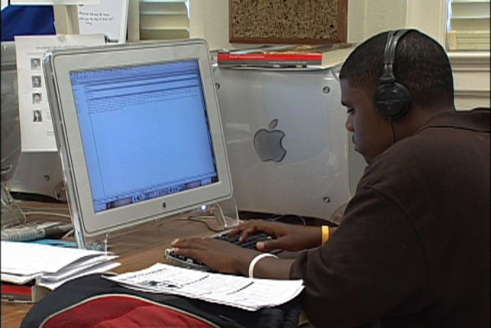
Graphic Designer
Career description:
construct commercial or promotional designs, such as packaging or logo graphics
utilize a variety of methods to achieve artistic or decorative effects
figure out size and arrangement of illustrative material

Slide 15
Graphic Designer
Career description:
generate new images with computer software
use layout principles and aesthetic design to create designs, concepts and sample layouts

Slide 16
Graphic Designer
Education/training:
bachelor’s degree or higher in graphic design generally required
Median salary:
$44,010

Slide 17
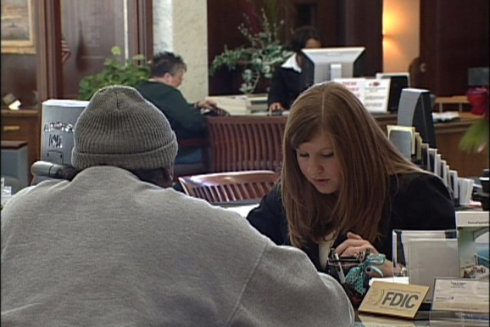
Research Specialist
Career description:
research market conditions to determine potential sales of a product or service
collect information on competitors, prices, sales and methods of marketing and distribution

Slide 18
Research Specialist
Career description:
develop a marketing campaign based on regional preferences and buying habits
discover potential markets and factors affecting product demand
determine and evaluate customer and employee satisfaction

Slide 19
Research Specialist
Education/training:
bachelor’s degree in marketing minimum requirement
master’s degree may be required for technical positions
Median salary:
$60,250

Slide 20
Advertising Sales Agent
Career description:
sell advertising for publications, signs, TV and radio time
obtain leases for outdoor advertising sites or have retailers use sales promotion display items

Slide 21
Advertising Sales Agent
Career description:
give sales presentations to sell new advertising programs and maintain existing advertising
inform customers of different advertising benefits
manage assigned account bases and develop new accounts

Slide 22
Advertising Sales Agent
Education/training:
bachelor’s degree in advertising or business administration preferred
Median salary:
$45,250

Slide 23
Advertising Manager
Career description:
organize advertising policies and programs
create interest with posters, contests, coupons or giveaways
plan budgets and submit estimates for program costs
create advertising and promotional material

Slide 24
Advertising Manager
Career description:
examine promotional material for quality
organize department activities, such as sales, graphic arts, media, finance and research

Slide 25
Advertising Manager
Education/training:
bachelor’s or master’s degree in business administration with an emphasis on marketing
Median salary:
$87,650

Slide 26
Discussion Questions
Describe the Marketing Communications Pathway and the careers available within the pathway.
What education and training requirements are needed for most careers in this pathway?
What are the working conditions for most careers in this pathway?

Slide 27
Discussion Questions
Describe the average earnings of some careers in this pathway and why they differ from other careers.
List three character traits you possess which would make you successful in a career in this pathway.

Slide 28
Resources
U.S. Department of Labor. Occupational Outlook Handbook.
Washington, D.C.: Jist Works, 2013.
http://online.onetcenter.org/

Slide 29
Acknowledgements
Production Coordinators
Holly Mannan
John Carroll
Graphics Designer
John Carroll
Technical Writer
Jessica Odom
Vice President of
Brand Management
Clayton Franklin
Executive Producers
Gordon Davis, Ph.D.
CEV Multimedia. Ltd.
©MMXIII

