Slide 2
Mobile Marketing
Is marketing which takes place via mobile devices
Makes use of mobile features to create marketing campaigns based on a customer's preferences
promotes personalized goods and services to network connected users
Encompasses all activities which connect businesses to consumers through mobile devices and networks

Slide 3
Mobile Marketing
Is the closest a company can get to their various customers
interacting with consumers through a mobile marketing campaigns is a very personal experience for consumers
Allows businesses to reach consumers which otherwise would not be reached through ads
10 percent of Americans own a smartphone and have no other form of high-speed Internet access at home beyond their phone’s data plan

Slide 4
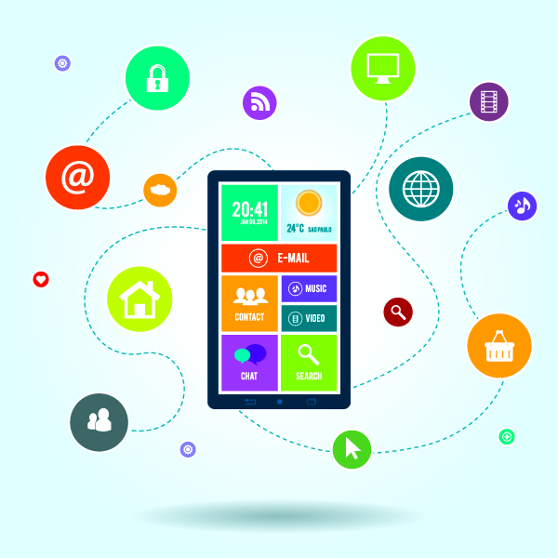
Mobile Marketing Methods
Include:
Short Message Service (SMS)
Multimedia Message Service (MMS)
Quick Response (QR) Codes
Location-based Services (LBS)
Push notifications
Mobile advergaming

Slide 5
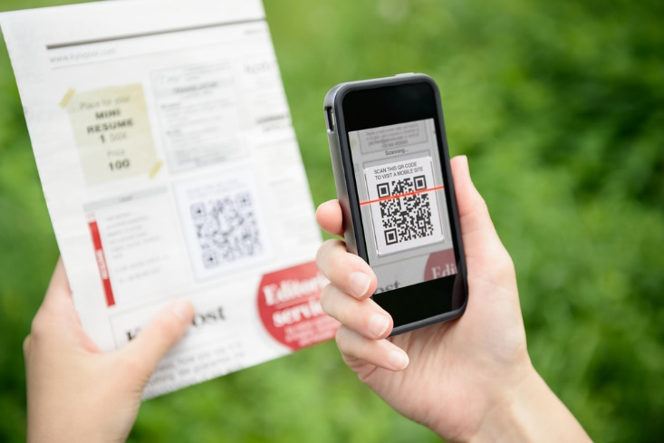
QR Codes
Are machine-readable codes used to transmit information to consumers
Consist of an array of black and white squares, which can be read by the camera on a smartphone
Can store up to 4,296 alphanumeric or 7,089 numeric characters
Fun Fact: You can create your very own QR Code at http://qrcode.kaywa.com

Slide 6
Location-Based Services
Is a software application for an IP-capable mobile device which requires knowledge about where the mobile device is located
mobile applications such as Foursquare, Facebook and Grubhub use LBS to better present information based on the consumer’s location

Slide 7
Push Notifications
Allows an application to notify a user of new messages or events even when the user is not actively using the app
an application's icon and a message appear in the status bar at the top of the smartphone or tablet’s screen

Slide 8
Mobile Advergaming
Features a downloadable or Internet-based computer game which in some way advertises a brand-name product, service or company during the game
for example: you might see a character eat a particular brand of fast food or a race car might drive past a billboard advertising a certain soft drink

Slide 9
Growth in Mobile Marketing
Is happening rapidly throughout the industry
46 percent of smartphone owners say their smartphone is something “they couldn’t live without”
84 percent of 13 to 17-year-olds own a mobile phone
81 percent of U.S. mobile owners used their device to research retail items before going to retail location

Slide 11
Businesses
Have had to adapt to the increasing number of mobile phone users by creating marketing campaigns centered around consumer’s mobile use
in 2010, $2.34 billion was spent on worldwide mobile advertising*
in 2015, $64.25 billion was spent on worldwide mobile advertising, an increase of $62.11 billion in global spending*
*according to Statista.com

Slide 12
Getting into Mobile Marketing
Include these key factors:
making the website mobile friendly
mobile-friendly displays encourage viewership
creating an attractive mobile search
ensure the business listings on various search engines are accurate and attractive
integrate texts into online marketing
allow customers to opt-in for text updates
decide to have or not have a mobile app
customers will use apps which entertains them in some way or allows access to their accounts

Slide 13
Steps of a Mobile Marketing Campaign
Include:
Define the goals
figure out what needs to be achieved, possible sales leads, newsletter signups
Research the target market
gain as much market understanding as possible to ensure the method is correct
includes gender, generation, economic situation, personal interests and so on

Slide 14
Steps of a Mobile Marketing Campaign
Include:
Plot the presence
decide which mediums to use (MMS, mobile website, Social Media) and how to utilize as many as possible in the campaign
Define the message
decide the tone and angle to will take to inspire the target audience to get involved
Create sharing opportunities
invite users to share content or information between social platforms

Slide 15
Steps of a Mobile Marketing Campaign
Include:
Feed the campaign
entice subscribers by releasing updates and encouraging renewed interest
Track, analyze and optimize
mobile marketing allows for precision analysis and tracking, making campaign optimization an ongoing process

Slide 16
Consumers
Use their mobile phones primarily to access text messaging services and social networking applications
97 percent of mobile phone users utilize text messaging more often than other apps
Use less than 10 mobile applications on a daily basis
creating the demand for new, visually attractive applications to engage consumers

Slide 17
Encouraging Consumer Loyalty
Is vital to consumer engagement and reengagement after downloading an app
offering new coupons, deals or discounts toward an in-app or in-store purchase brings new interest to an app

Slide 18
Pros of Mobile Marketing
Include:
convenient
consumers already carry their phones with them everywhere
instantaneous
allows for instant feedback
nearly 98 percent of text messages are opened after being received

Slide 19
Cons of Mobile Marketing
Include:
privacy
consumers question how safe their information is when signing up for a mobile campaign
availability
roughly two thirds of U.S. adults own a smartphone

Slide 20
Acknowledgements
Forbes Magazine; http://www.forbes.com/
Entrepreneur; 4 Critical Things Every Business Must Know About Mobile Marketing; https://www.entrepreneur.com/article/244215
Pew Research Center; U.S. Smartphone Use in 2015; http://www.pewinternet.org/2015/04/01/us-smartphone-use-in-2015/
Chief Marketing Officer Council World Wide; Mobile Marketing; Facts & Stats; https://www.cmocouncil.org/facts-stats-categories.php?view=all&category=mobile-marketing
eMarketer; Mobile Ad Spend to Top $100 Billion Worldwide in 2016, 51% of Digital Market; http://www.emarketer.com/Article/Mobile-Ad-Spend-Top-100-Billion-Worldwide-2016-51-of-Digital-Market/1012299

