Slide 1
Restaurants &
Food/Beverage
Services

Slide 2
Objectives
To gain a basic understanding of the Restaurants and Food/Beverage Services Pathway.
To discover career options available within the Restaurants and Food/Beverage Services Pathway.
To explore the working environment, educational requirements, skills needed and salary of careers available within the Restaurants and Food/Beverage Services Pathway.

Slide 3
Pathway Overview
Careers focus on the preparation of food products, as well as the management of the food and beverage industry
Duties include:
managing restaurants
preparing meals and beverages
waiting and serving guests

Slide 4
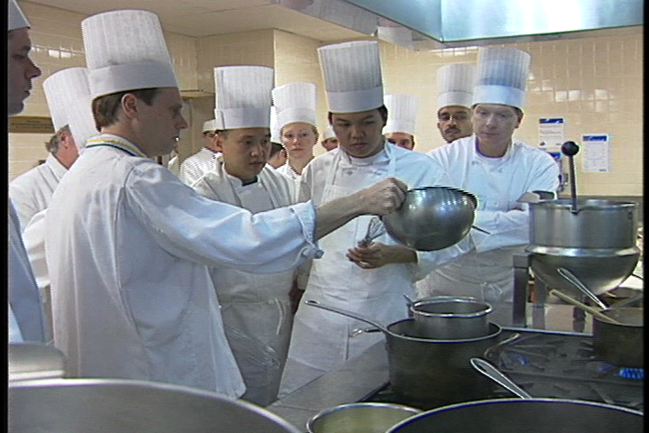
Food & Beverage Manager
Career description:
direct activities of organizations serving food and beverages
taste and smell food to ensure quality and flavor

Slide 5
Food & Beverage Manager
Career description:
investigate and resolve complaints regarding food quality, service or accommodations
regulate food preparation, portion sizes and presentation of food
monitor budgets and payroll records

Slide 6
Food & Beverage Manager
Education/training:
bachelor’s degree in restaurant and institutional food services is preferred
master’s degree in hospitality management programs ideal
internships and real life experience required in these programs

Slide 7
Food & Beverage Manager
Education/training:
experience in the restaurant industry important
Median salary:
$48,110

Slide 8
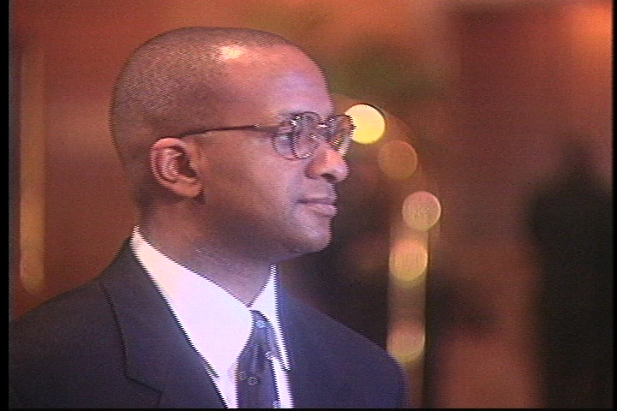
Maitre d’
Career description:
greet customers, show them to the table and ensure quality of the experience
provide guests with menus

Slide 9
Maitre d’
Career description:
examine dining and serving areas to guarantee cleanliness and nice setup
speak with guests to ensure satisfaction with food and service and handle complaints
operate cash registers

Slide 10
Maitre d’
Education/training:
high school diploma preferred
major source of part-time employment for high school and college students
Median salary:
$18,560

Slide 11
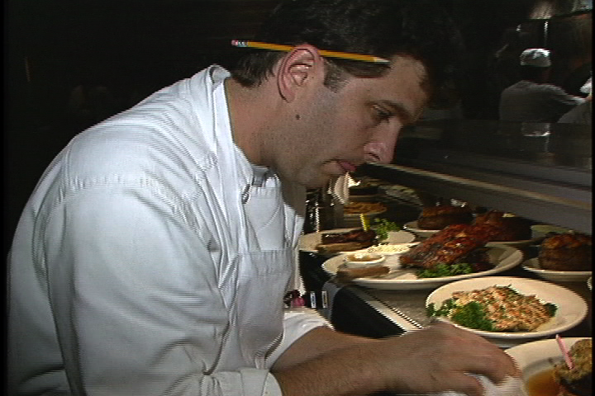
Executive Chef
Career description:
direct preparation, seasoning and cooking of all food dishes
assist in the planning and pricing of menus

Slide 12
Executive Chef
Career description:
order supplies, keep records and accounts
decide on food presentation

Slide 13
Executive Chef
Career description:
enforce food safety standards
ensure employees follow sanitation standards and regulations

Slide 14
Executive Chef
Education/training:
two and four year college degrees in hospitality or culinary arts
attend independent culinary schools or professional culinary institutes
years of training and experience required

Slide 15
Executive Chef
Median salary:
$42,350

Slide 16
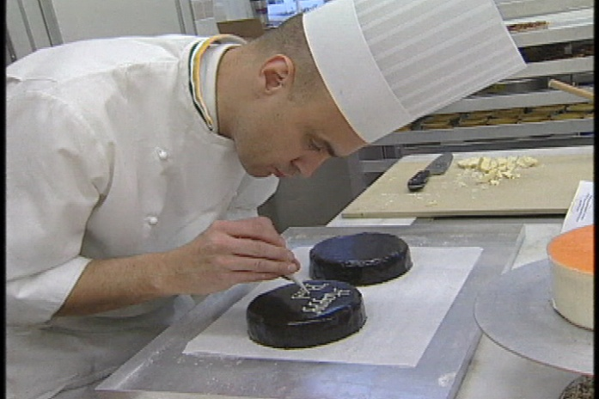
Pastry & Specialty Chef
Career description:
produce breads, cookies, cakes, pies, pastries and other baked goods

Slide 17
Pastry & Specialty Chef
Career description:
set oven temperatures and place food into hot ovens
mix or blend measured ingredients
ensure quality of ingredients

Slide 18
Pastry & Specialty Chef
Education/training:
high school diploma required
learn skills on-the-job
Median salary:
$23,250

Slide 19
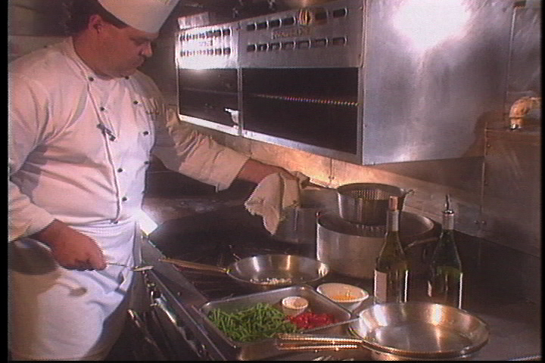
Cook
Career description:
prepare, season and cook foods in restaurants
order supplies, keep records and accounts of inventory

Slide 20
Cook
Career description:
examine food preparation and serving areas to ensure safe and sanitary food-handling
observe and test foods to ensure cooked properly

Slide 21
Cook
Education/training:
high school diploma required
high school or vocational courses in food safety and handling procedures
internships provide great experience
Median salary:
$22,080

Slide 22
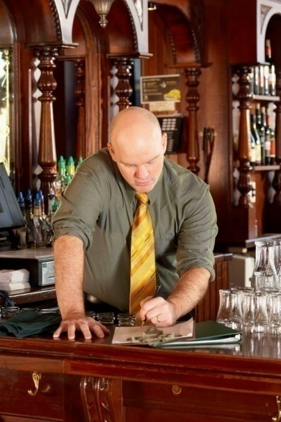
Bartender & Server
Career description:
mix and serve drinks to customer
clean facility
enforce laws and regulations regarding the serving of alcoholic beverages

Slide 23
Bartender & Server
Career description:
check identification to ensure customers are the legal age to purchase alcohol
collect money

Slide 24
Bartender & Server
Education/training:
must be at least 21 years old
familiar with state and local laws related to the sale of alcoholic beverages

Slide 25
Bartender & Server
Education/training:
attend bartending or vocational school
Median salary:
$18,850

Slide 26
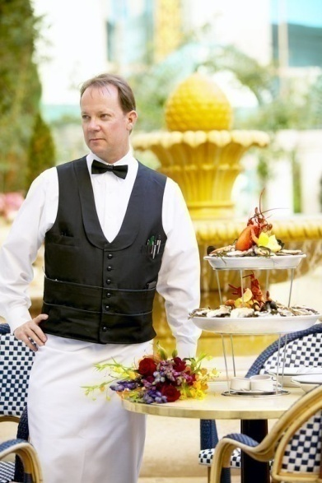
Banquet Set-Up Employee
Career description:
prepare public or private events for companies and organizations
clean tables, carry dirty dishes, replace table linens and set tables

Slide 27
Banquet Set-Up Employee
Career description:
clean dirty linens, silverware, glassware and dishes
provide service bar with food
serve guests

Slide 28
Banquet Set-Up Employee
Education/training:
high school diploma or less is preferred
Median salary:
$18,420

Slide 29
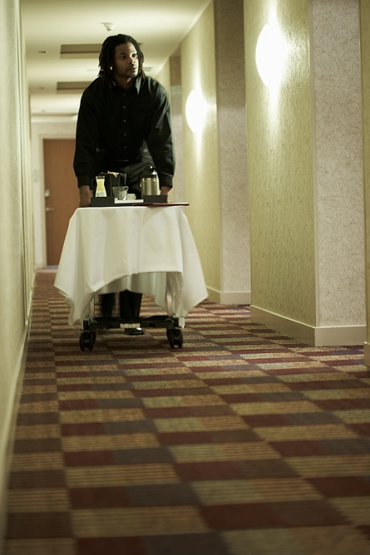
Room Service Attendant
Career description:
serve food to customers in a non-restaurant setting, such as hotels or hospital rooms
ensure meals and special requests are delivered to the correct customer
clean dishes and facilities

Slide 30
Room Service Attendant
Education/training:
high school diploma or less is required
Median salary:
$18,420

Slide 31
Wine Steward
Career description:
check on customer to make sure they are enjoying their meals
collect payment from customers
take patrons orders for food or beverages
clean tables or counters after patrons are finished

Slide 32
Wine Steward
Education/training:
high school diploma usually required
mostly on the job training
Median salary:
$18,570

Slide 33
Discussion Questions
Describe the Restaurants and Food/Beverage Services Pathway and the careers available within the pathway.
What education and training requirements are needed for most careers in this pathway?
What are the working conditions for most careers in this pathway?

Slide 34
Discussion Questions
Describe the average earnings of some careers in this pathway and why they differ from other careers.
List three character traits you possess which would make you successful in a career in this pathway.

Slide 35
Resources
U.S. Department of Labor. Occupational Outlook Handbook.
Washington, D.C.: Jist Works, 2013.
http://online.onetcenter.org/

Slide 36
Acknowledgements
Production Coordinators
Holly Mannan
John Carroll
Graphics Designer
John Carroll
Technical Writer
Jessica Odom
Vice President of
Brand Management
Clayton Franklin
Executive Producer
Gordon Davis, Ph.D.
CEV Multimedia. Ltd.
©MMXIII

