Slide 1
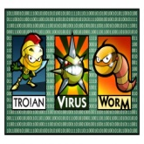
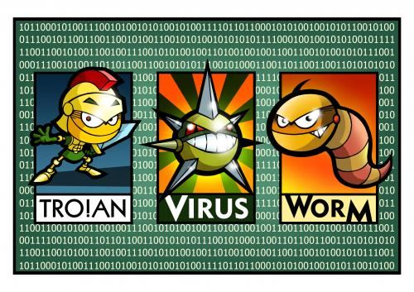
Viruses, Worms & Trojans
What is the difference?

Slide 2
The internet is dangerous…
We have a lot of things to look out for.

Slide 3
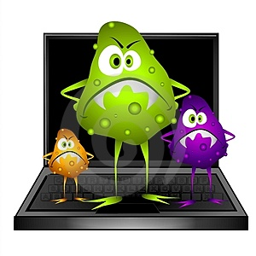
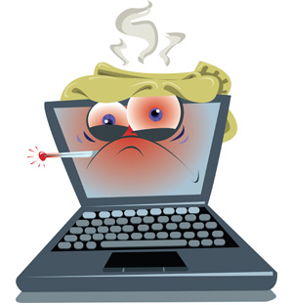
Viruses (AKA Hitchhikers)
Attach document on e-mails or IM’s
After opened the virus gets to work
Causes damage to files and your computer

Slide 4
Worms
Do not damage software
Use internet security loopholes
Create copies on your computer and other systems
Slow down your computer

Slide 5
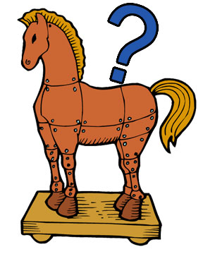
Trojans
Disguised as something you want:
Pictures, Updates, Jokes
File opens gate on your computer
Gate allows others in to take information:
Identification (ID)
Banking Information
Passwords
IP Address (IP’s are stolen to use your computer to commit crimes)
Why Trojan? A Greek myth describes the successful defeat of Troy by hiding their army in a wooden horse. Trojans end up on your computer in the same way. They hide inside of a file on your computer.

Slide 6
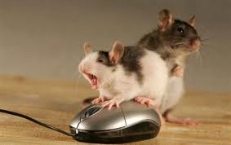
Avoiding the problem…
Whatever you do don’t click it. Don’t click it!
Oh no!!!
Unknown Sender = Don’t Click!
Chain Letters = Don’t Click!
Weird information from trusted person = Don’t Click!
Downloads from unknown site of music, videos, software = Don’t Click!
What is a trusted site?

Slide 7
Solving the problem…
Update your operating system when you get that message from a trusted software.
(Example: Windows Update: Microsoft Corp.)
Use a trusted internet security software: Viruses, Spyware, Malware
Update your security software
Check your bank statements
Let your friends and family know if your e-mail has been hacked.
Change your passwords after scanning your computer.
Windows Update Logo

