Slide 2
Objectives
To gain a basic understanding of the Counseling and Mental Health Services Pathway.
To discover career options available within the Counseling and Mental Health Services Pathway.
To explore the working environment, educational requirements, skills needed and salary of careers available within the Counseling and Mental Health Services Pathway.

Slide 3
Pathway Overview
Careers focus on counseling individuals with various issues including:
personal problems and handicaps
social difficulties
educational disabilities
mental health disorders
career management issues

Slide 4
Career Counselor
Career description:
offer group occupational guidance services
counsel students on educational issues and career planning

Slide 5
Career Counselor
Career description:
counsel individuals to help them overcome personal, social or behavioral problems affecting their educational or occupational situations

Slide 6
Career Counselor
Career description:
help individuals develop job-searching and obtaining skills
evaluate clients’ education, training, work history, personality and abilities to assist in career making decisions

Slide 7
Career Counselor
Education/training:
bachelor’s degree with appropriate counseling courses may be required
master’s degree typically required
most states require licensure
Median salary:
$54,130

Slide 8
Clinical Psychologist
Career description:
evaluate and diagnose mental and emotional disorders
observe, interview and use psychological tests to determine treatment for psychological, emotional or behavioral issues

Slide 9
Clinical Psychologist
Career description:
write detailed reports on clients’ situations and treatments
use various forms of therapy to treat clients

Slide 10
Clinical Psychologist
Education/training:
doctoral degree is generally required
Median salary:
$67,880

Slide 11
Counseling Psychologist
Career description:
assess and evaluate individuals' problems through a variety of methods
help individuals achieve effective personal, social, educational and vocational development and adjustment

Slide 12
Counseling Psychologist
Career description:
provide counsel to individuals, groups or families to help understand problems, set goals and make plans
provide schools, social service agencies and businesses with consulting services

Slide 13
Counseling Psychologist
Career description:
may work in university counseling centers, hospitals and individual or group practices

Slide 14
Counseling Psychologist
Education/training:
doctoral degree typically required
Median salary:
$67,880

Slide 15
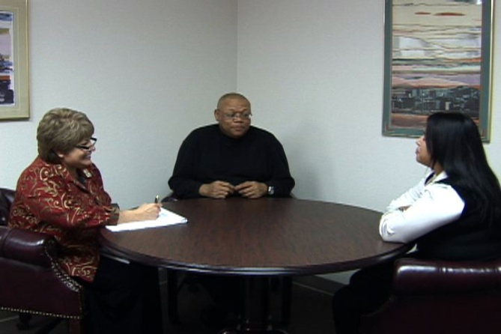
Marriage, Child & Family Counselor
Career description:
counsel clients on unsatisfactory relationships, divorce and separation, raising children, home management and financial issues
help individuals and family members develop skills to handle problems constructively

Slide 16
Marriage, Child & Family Counselor
Career description:
diagnose and treat mental and emotional disorders within marriage and families
use psychotherapeutic and family systems theories and techniques for treatment

Slide 17
Marriage, Child & Family Counselor
Education/training:
master’s degree minimum education requirement
most states require licensure
Median salary:
$46,240

Slide 18
Rehabilitation Counselor
Career description:
aid people dealing with personal, social and occupational effects of disabilities
counsel people with disabilities from birth defects, illness or disease, accidents and stresses of daily life

Slide 19
Rehabilitation Counselor
Career description:
evaluate strengths and weaknesses of clients
with the help of physicians, family members, psychologists and others determine capabilities and skills of client

Slide 20
Rehabilitation Counselor
Career description:
create program to help client develop work-related skills
may help client learn to live independently

Slide 21
Rehabilitation Counselor
Education/training:
master’s degree typically minimum educational requirement
bachelor’s degree with appropriate counseling courses acceptable in some situations

Slide 22
Rehabilitation Counselor
Education/training:
most states require licensure
Median salary:
$33,740

Slide 23
Mental Health Counselor
Career description:
assist families, individuals and groups in treating mental and emotional disorders
promote mental health practices through various treatments and techniques

Slide 24
Mental Health Counselor
Career description:
trained to treat depression, addiction, substance abuse, suicidal tendencies and other issues
often work closely with other mental health specialists

Slide 25
Mental Health Counselor
Education/training:
master’s degree typically minimum educational requirement
bachelor’s degree with appropriate counseling courses may be acceptable
Median salary:
$39,190

Slide 26
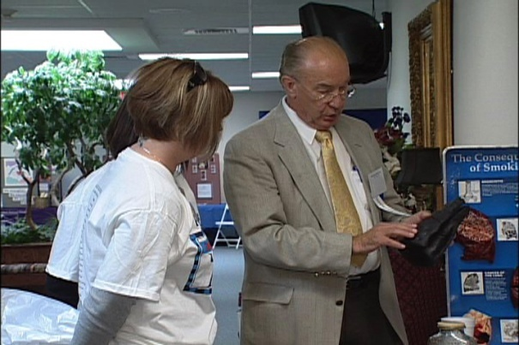
Substance Abuse/Behavioral Disorder Counselor
Career description:
help people who have problems with alcohol, tobacco, drugs, gambling and eating disorders
may work with individuals, families or groups

Slide 27
Substance Abuse/Behavioral Disorder Counselor
Career description:
may be involved in prevention programs
help individuals recognize behaviors and problems related to their addiction

Slide 28
Substance Abuse/Behavioral Disorder Counselor
Education/training:
master’s degree typically minimum educational requirement
bachelor’s degree with appropriate counseling courses may be acceptable
Median salary:
$38,560

Slide 29
Sociologist
Career description:
study human society and behaviors to better understand relationships
examine groups and social institutions formed by people
may study the behavior and interaction of groups

Slide 30
Sociologist
Career description:
trace the origin and growth of different groups
in some cases, teach sociology courses
create publications and reports on research findings
collect data regarding the attitudes, values and behaviors of people

Slide 31
Sociologist
Education/training:
doctoral degree or equivalent minimum educational requirement for employment at universities or colleges and for nonacademic research positions
internships and field experience helpful

Slide 32
Sociologist
Median salary:
$73,670

Slide 33
Industrial-Organization Psychologist
Career description:
apply psychological principles and research methods to the workplace to improve productivity and quality of work life
work as a consultant hired by management to solve problems

Slide 34
Industrial-Organization Psychologist
Career description:
help with policy planning, screening, training and counseling job applicants
restructure organizational development and assessment
examine job requirements to determine criteria for hiring and training employees

Slide 35
Industrial-Organization Psychologist
Education/training:
master’s degree generally minimum educational requirement
practical experience generally required
Median salary:
$94,720

Slide 36
Discussion Questions
Describe the Counseling and Mental Health Services Pathway and the careers available within the pathway.
What education and training requirements are needed for most careers in this pathway?
What are the working conditions for most careers in this pathway?

Slide 37
Discussion Questions
Describe the average earnings of some careers in this pathway and why they differ from other careers.
List three character traits you possess which would make you successful in a career in this pathway.

Slide 38
Resources
U.S. Department of Labor. Occupational Outlook Handbook.
Washington, D.C.: Jist Works, 2013.
http://online.onetcenter.org/

Slide 39
Acknowledgements
Production Coordinator
Holly Mannan
John Carroll
Graphics Designer
John Carroll
Technical Writer
Jessica Odom
Vice President of
Brand Management
Clayton Franklin
Executive Producer
Gordon Davis, Ph.D.
CEV Multimedia. Ltd.
©MMXIII

