Slide 1
Visual
Arts

Slide 2
Objectives
To gain a basic understanding of the Visual Arts Pathway.
To discover career options available within the Visual Arts Pathway.
To explore the working environment, educational requirements, skills needed and salary of careers available within the Visual Arts Pathway.

Slide 3
Pathway Overview
Careers focus on the creation of artistic pieces through the use of several different materials
Types of art can include:
paintings
statues
animations
photographs

Slide 4
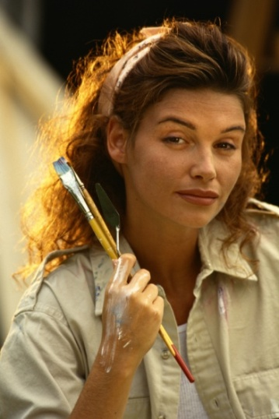
Painter/Sculptor/Illustrator
Career description:
create original artwork through painting, sculpting and drawing
use various materials like pens and ink, watercolors, charcoal, oil or computer software

Slide 5
Painter/Sculptor/Illustrator
Career description:
communicate with clients, editors, writers, art directors and others to determine art needs

Slide 6
Painter/Sculptor/Illustrator
Education/training:
bachelor’s degree or higher in fine arts
associate’s or bachelor’s degree from an independent art and design school
Median salary:
$44,600

Slide 7
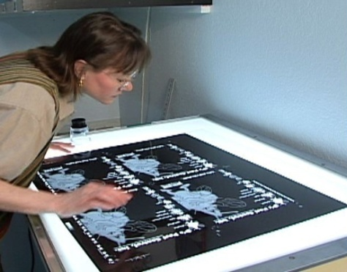
Art Director
Career description:
make decision regarding overall theme and design of projects
oversee workers involved with art work, layout design and copy writing for visual communications media

Slide 8
Art Director
Career description:
examine and approve proofs of printed copy and art materials
manage accounts and projects
set and follow budgeting and scheduling needs

Slide 9
Art Director
Education/training:
bachelor’s degree or higher in a related field such as graphic design or advertising preferred
Median salary:
$81,260

Slide 10
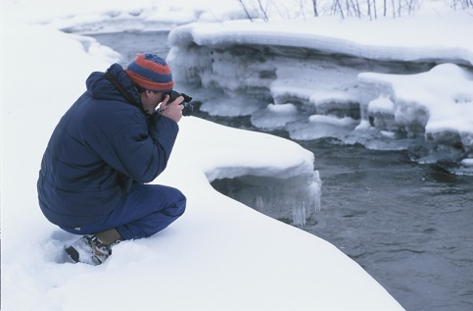
Commercial Photographer
Career description:
capture photographs of people, subjects, merchandise or other products for display
process negatives and create finished prints

Slide 11
Commercial Photographer
Career description:
take photos of individuals, families and groups in studios or on location
alter camera and lighting to achieve the best picture

Slide 12
Commercial Photographer
Career description:
operate traditional or digital cameras and equipment such as tripods, filters and flash attachments

Slide 13
Commercial Photographer
Education/training:
college or bachelor’s degree in photography or a related field usually required
Median salary:
$28,860

Slide 14
Interior Designer
Career description:
create and furnish interior of residential, commercial or industrial buildings
plan designs to fill the intended purposes of the client

Slide 15
Interior Designer
Career description:
some focus on a particular area, style or phase of interior design such as painting or furnishings
approximate material needs and costs
show design ideas to client for approval

Slide 16
Interior Designer
Career description:
work with client to establish budget, purpose and function of design
assist client with space planning, layout, furnishings and color schemes
choose furnishings, art works and other accessories

Slide 17
Interior Designer
Education/training:
bachelor’s degree or higher in interior design
Median salary:
$47,620

Slide 18
Set Designer
Career description:
create unique exhibits, along with movie, television and theater sets and backgrounds
review scripts, communicate with directors and perform research to learn correct settings of film

Slide 19
Set Designer
Career description:
study objects to be placed in exhibits and sets in order to plan how best to display them
find specimens or graphics needed to finish sets
create rough drafts and scale working drawings of sets

Slide 20
Set Designer
Education/training:
bachelor’s degree or higher in a related field
Median salary:
$48,480

Slide 21
Fashion Designer
Career description:
create clothing and accessory designs
design garments for various audiences and customers
choose color and materials to be used in construction

Slide 22
Fashion Designer
Career description:
organize workers who draw and cut patterns and make samples or finished garments
study sample garments on and off models and alter them to achieve wanted effects
create drawings of apparel or accessories

Slide 23
Fashion Designer
Education/training:
associate’s or bachelor’s degree in fashion design
Median salary:
$64,690

Slide 24
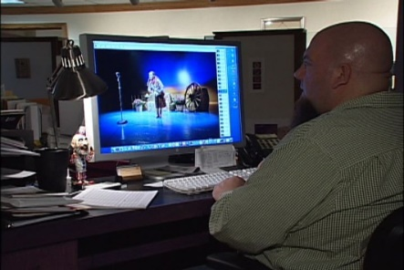
Multimedia Artist/Animator
Career description:
develop special effects, animations or other images with film, video, computers or other graphics generating equipment
create graphics and animation, using, creativity and computer equipment

Slide 25
Multimedia Artist/Animator
Career description:
develop two-dimensional and three-dimensional images with computer animation or modeling programs
change light, color, texture and other features to change image appearance

Slide 26
Multimedia Artist/Animator
Education/training:
bachelor’s degree or higher in a related field such as graphic design
Median salary:
$60,830

Slide 27
Discussion Questions
Describe the Visual Arts Pathway and the careers available within the pathway.
What education and training requirements are needed for most careers in this pathway?
What are the working conditions for most careers in this pathway?

Slide 28
Discussion Questions
Describe the average earnings of some careers in this pathway and why they differ from other careers.
List three character traits you possess which would make you successful in a career in this pathway.

Slide 29
Resources
U.S. Department of Labor. Occupational Outlook Handbook.
Washington, D.C.: Jist Works, 2013.
http://online.onetcenter.org/

Slide 30
Acknowledgements
Production Coordinators
Holly Mannan
John Carroll
Graphics Designer
John Carroll
Technical Writer
Jessica Odom
Vice President of
Brand Management
Clayton Franklin
Executive Producer
Gordon Davis, Ph.D.
CEV Multimedia. Ltd.
©MMXIII

